Slide 1
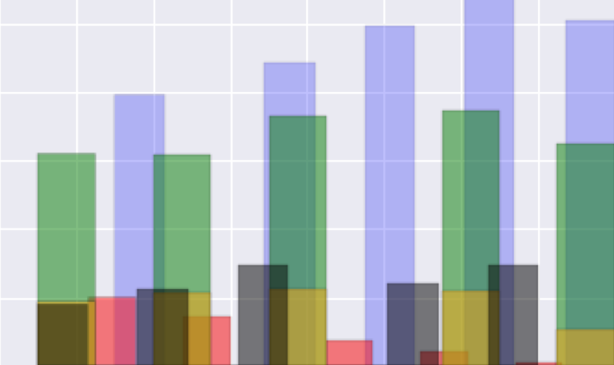
Project 4: Cash, Cash, Bang, Bang
Byron Allen
Data Science Student at General Assembly
10 October 2016

Slide 2
Overview
Goal >>> identify feature(s) that are best predictor of salary
Used ‘data scientist’ key word
Scraped job postings from Indeed.com
Import scraped data and clean
Convert salaries into USD
Explore shape of dataset
Select 8 optimal bins for salaries
Create CVSvDummy function to print results
Model with logistical regression
Identify key words (from job titles) associated with salary
Identify key words (from job descriptions) associated with salary

Slide 3
Overview
Goal >>> identify feature(s) that are best predictor of salary
Used ‘data scientist’ key word
Scraped job postings from Indeed.com
Import scraped data and clean
Convert salaries into USD
Explore shape of dataset
Select 8 optimal bins for salaries
Create CVSvDummy function to print results
Model with logistical regression
Identify key words (from job titles) associated with salary
Identify key words (from job descriptions) associated with salary

Slide 4
Overview
Goal >>> identify feature(s) that are best predictor of salary
Used ‘data scientist’ key word
Scraped job postings from Indeed.com
Import scraped data and clean
Convert salaries into USD
Explore shape of dataset
Select 8 optimal bins for salaries
Create CVSvDummy function to print results
Model with logistical regression
Identify key words (from job titles) associated with salary
Identify key words (from job descriptions) associated with salary

Slide 5
Overview
Goal >>> identify feature(s) that are best predictor of salary
Used ‘data scientist’ key word
Scraped job postings from Indeed.com
Import scraped data and clean
Convert salaries into USD
Explore shape of dataset
Select 8 optimal bins for salaries
Create CVSvDummy function to print results
Model with logistical regression
Identify key words (from job titles) associated with salary
Identify key words (from job descriptions) associated with salary

Slide 6
Overview
Goal >>> identify feature(s) that are best predictor of salary
Used ‘data scientist’ key word
Scraped job postings from Indeed.com
Import scraped data and clean
Convert salaries into USD
Explore shape of dataset
Select 8 optimal bins for salaries
Create CVSvDummy function to print results
Model with logistical regression
Identify key words (from job titles) associated with salary
Identify key words (from job descriptions) associated with salary

Slide 7
Scrape
2700 job posts on Indeed.com
Sydney, Melbourne, San Francisco, New York, Newark and Chicago
Built DataScienceJobSearch function to automate scraping through:
City
Salary bin
Define max number of pages
Crawl all pages
Company page
Glean company review scores
Print all URLs

Slide 8
Huge Difference Between Locations

Slide 9
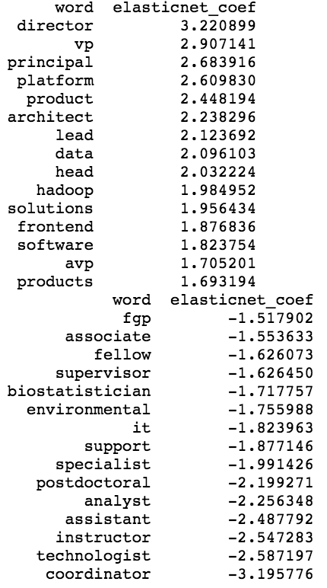
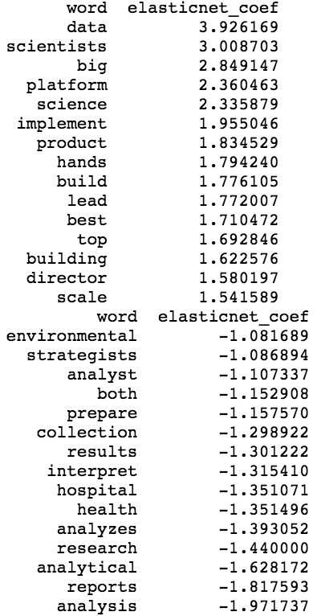
Word Impact on Salary
Best/Worst Words from Job Title
Best/Worst Words from Job Description

Slide 10
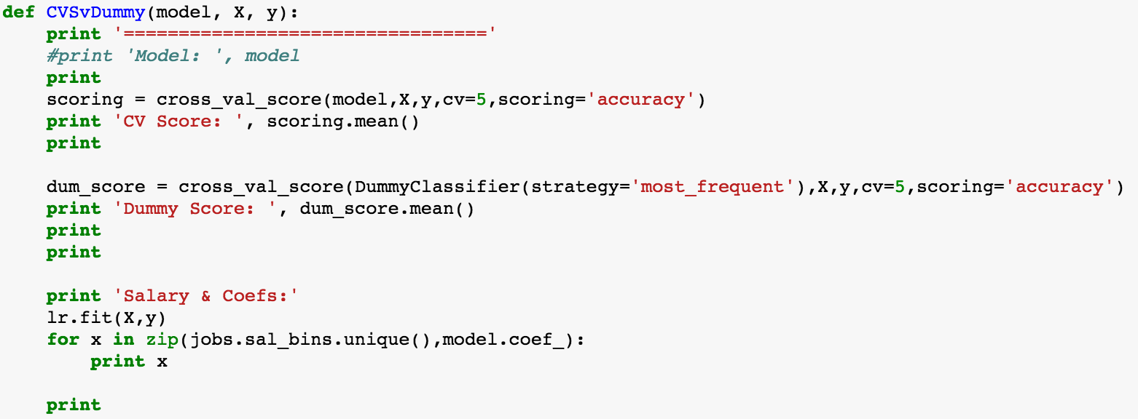
Function to Speed Up Tests

Slide 11
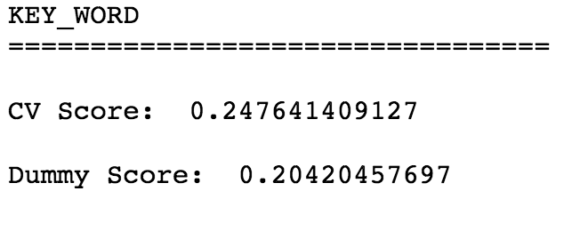
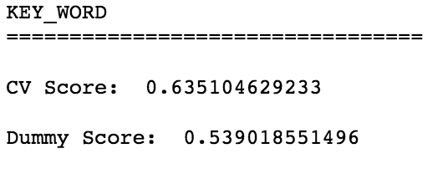
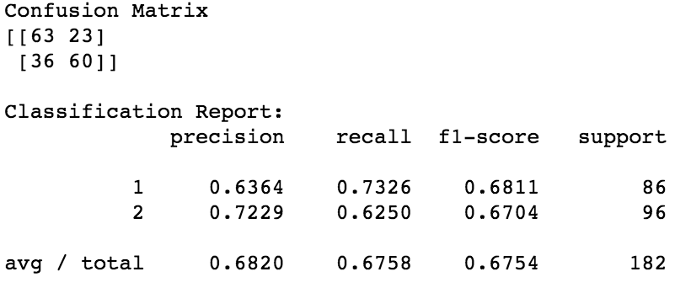
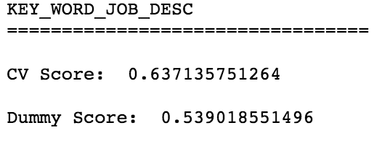
Key Words are Best Predictor, but…

Slide 12
Key Words are Best Predictor, but…

Slide 13
Key Words are Best Predictor, but…

Slide 14
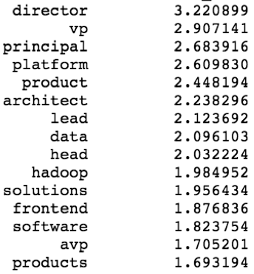
Final Words… to aspire to?

